Slide 1
Ivan Kralj 6.a

Slide 2
Capital is a city of England
the biggest city in Europe
rich in monuments and works of art

Slide 3
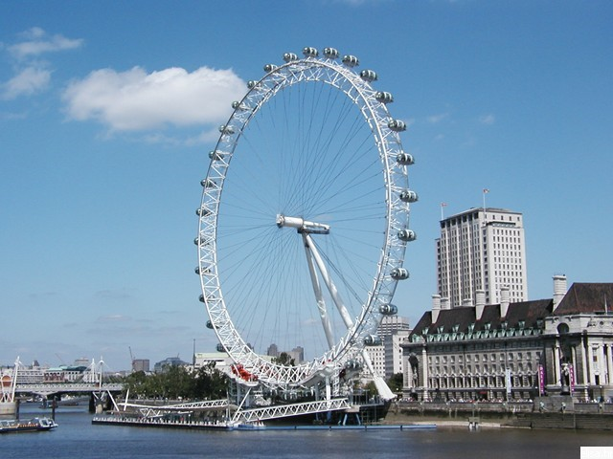
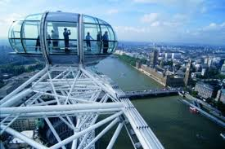
London Eye
A major tourist attraction in London
third is the tallest wheel in the world and first in Europe.

Slide 4
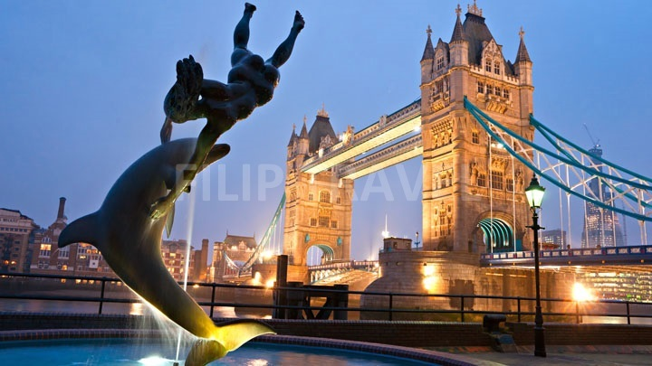
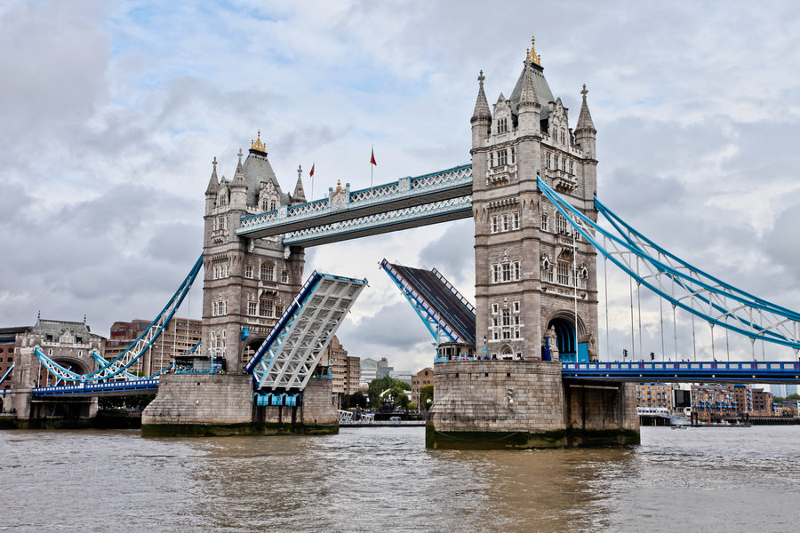
Tower Bridge
Opens for the big ship to pass
Bascule and suspension bridge in London
which crosses the River Thames

Slide 5
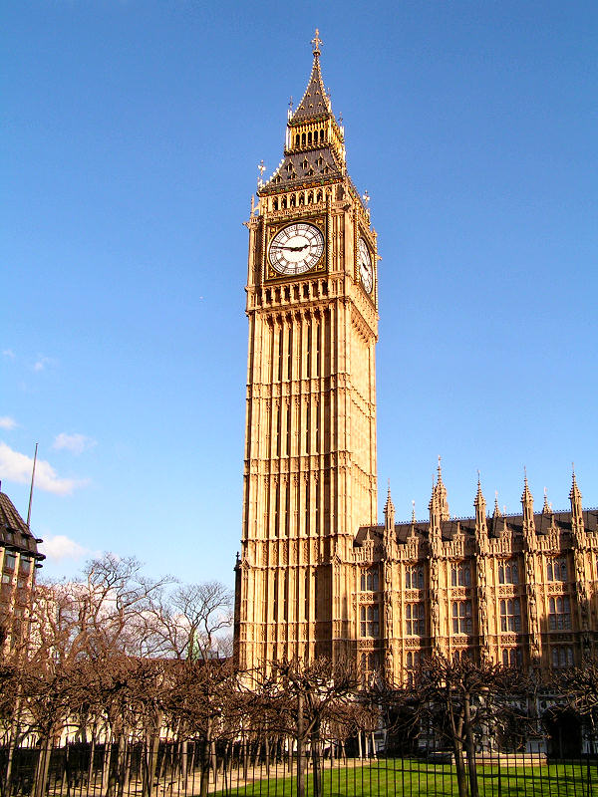
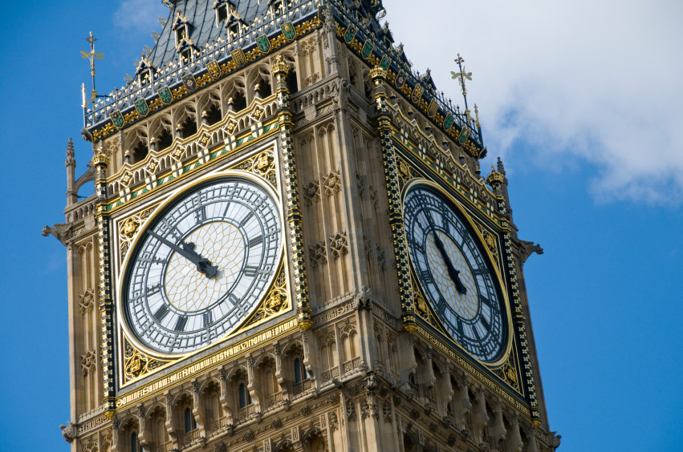
Big Ben
Big Ben is the largest clock and the third highest clock tower in the world

Slide 6
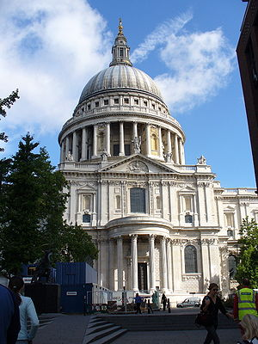
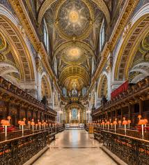
St Paul’s Cathedral
The first cathedral of the Protestant Church of England
Other church in the world by length

Slide 7
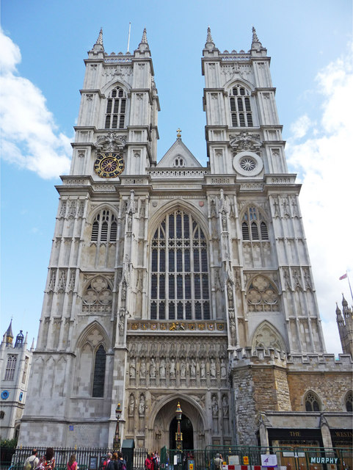
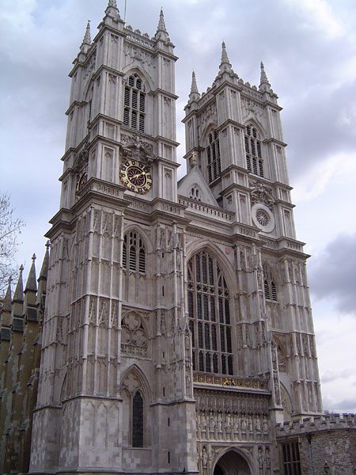
Westminster Abbey
The most famous church where kings and queens are crowned, married and buried
Gothic church
Tombs of many famous people

Slide 8
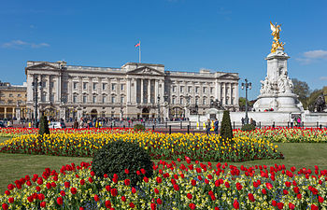
Buckingham Palace
Is the home of British monarchs, as well as a famous tourist attraction

Slide 9
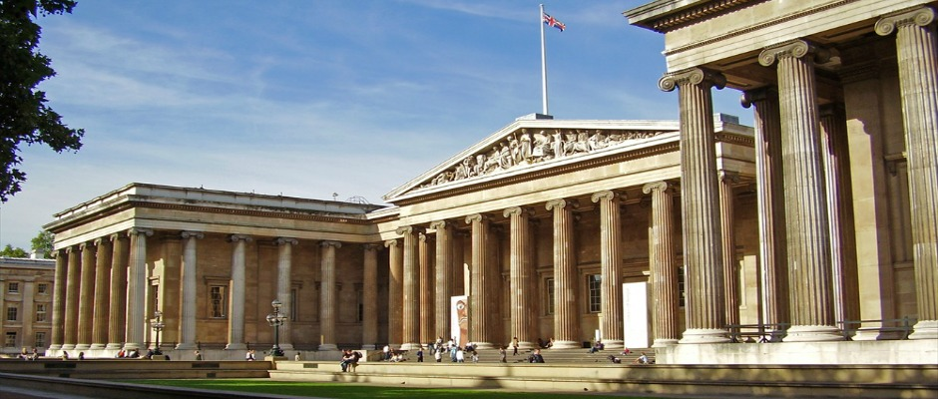
British Museum
Is a museum dedicated to the history of humanity and culture of London
Has two Institutions; National Museum of Antiquities, and the national library

Slide 10
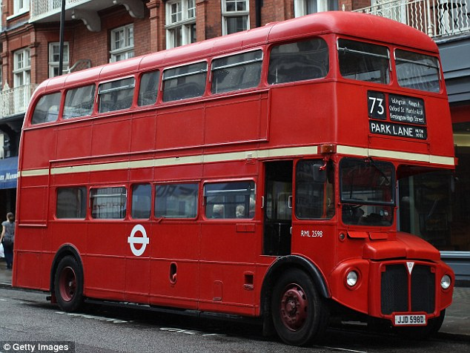
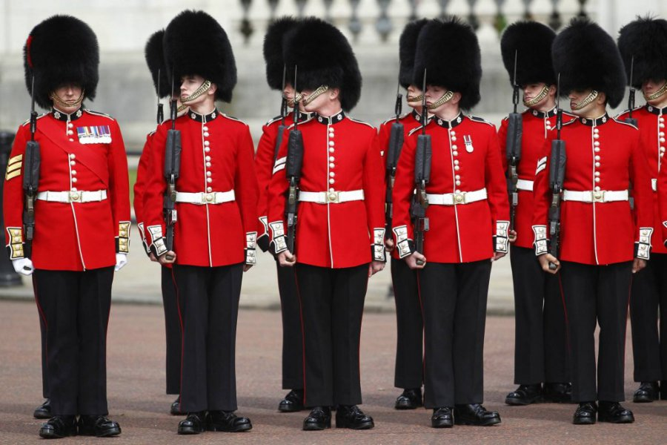
Symbols london
red telephone booths
red bus
Guard in London

