Slide 1
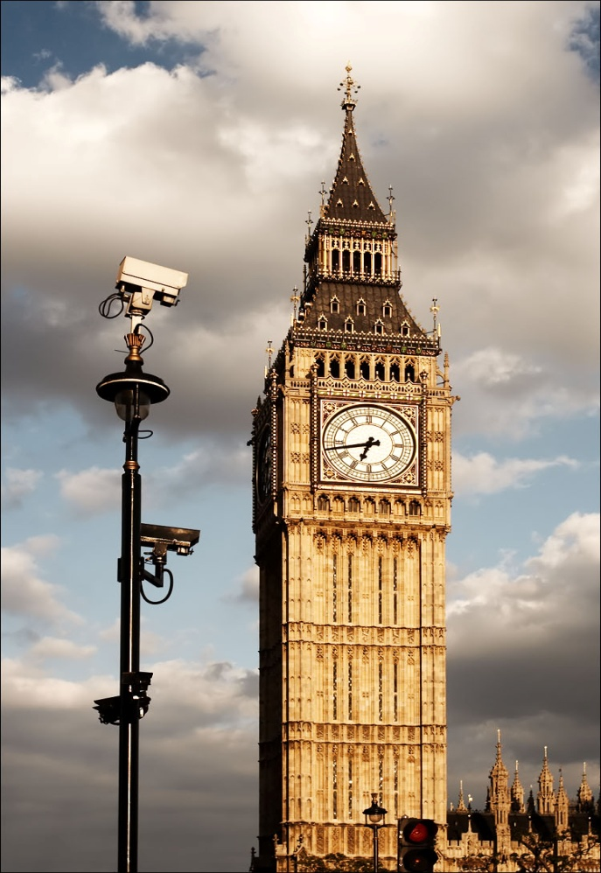
Big Ben
Luka Totgergeli and
Benjamin Takač 5b

Slide 2
Big Ben is the nickname for the great bell of the clock at the north end of the Palace of Westminster.
The tower is now officially called the Elizabeth Tower.
The tower was completed in 1858. and had its 150th anniversary on 31. May 2009.
The Elizabeth Tower has become one of the most prominent symbols of both London and England and is often in the establishing shot of films set in the city.

Slide 3
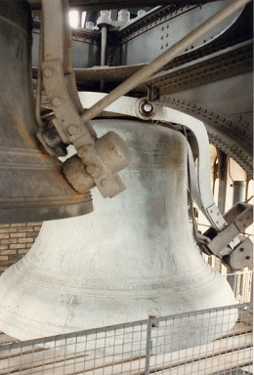
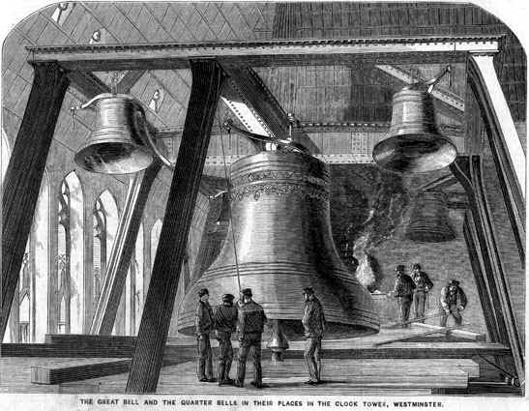
The main bell, officially known as the Great Bell, is the largest bell in the tower and part of the Great Clock of Westminster. The bell is better known by the nickname Big Ben.
The original bell was a 16 ton (16.3-tonne) hour bell, cast on 6 August 1856 in Stockton-on-Tees by John Warner & Sons.
Bell now and
before

Slide 4
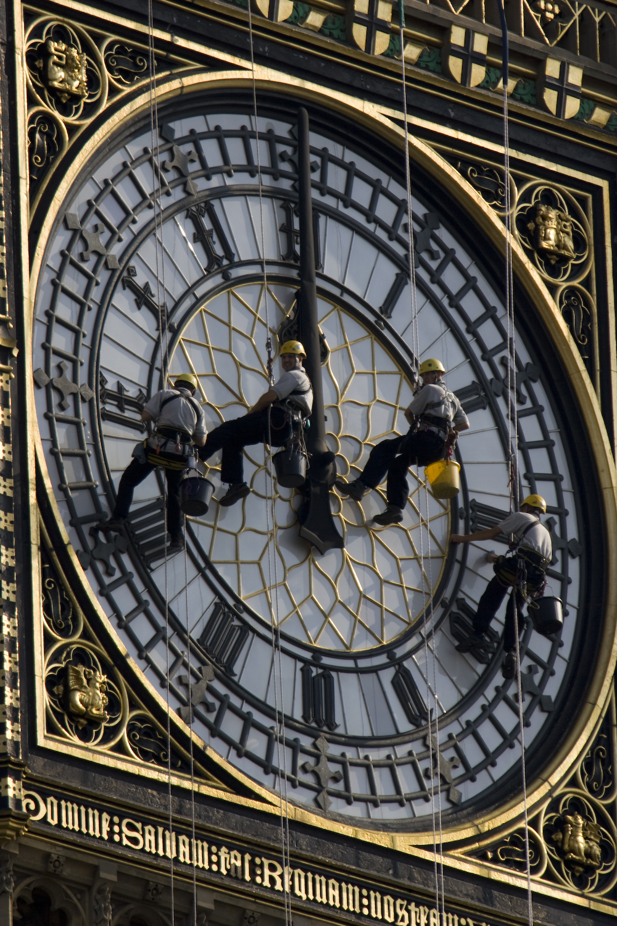
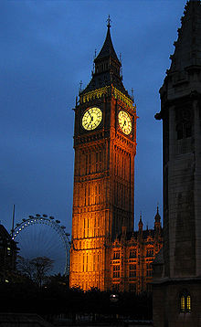
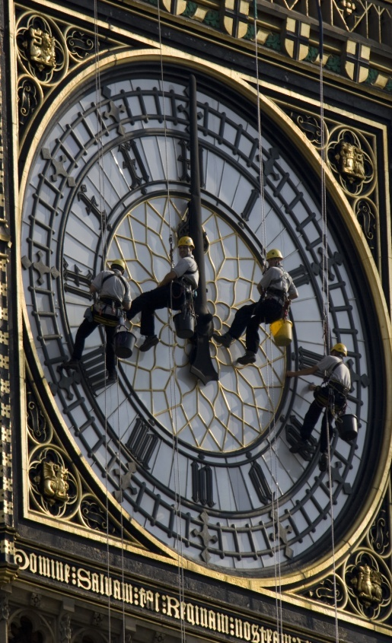
This is the south clock that restored 11th August 2007
Big Ben at night

Slide 5
Westminster Palace
The Palace of Westminster is the meeting place of the House of Commons and the House of Lords, the two houses of the Parliament of the United Kingdom.
Commonly known as the Houses of Parliament after its tenants, the Palace lies on the Middle Ages bank of the River Thames in the City of Westminsters, in central London.
Its name, which derives from the neighbouring Westminster Abbey, may refer to either of two structures: the Old Palace, a medieval building complex that was destroyed by fire in 1834, and its replacement New Palace that stands today.

Slide 6
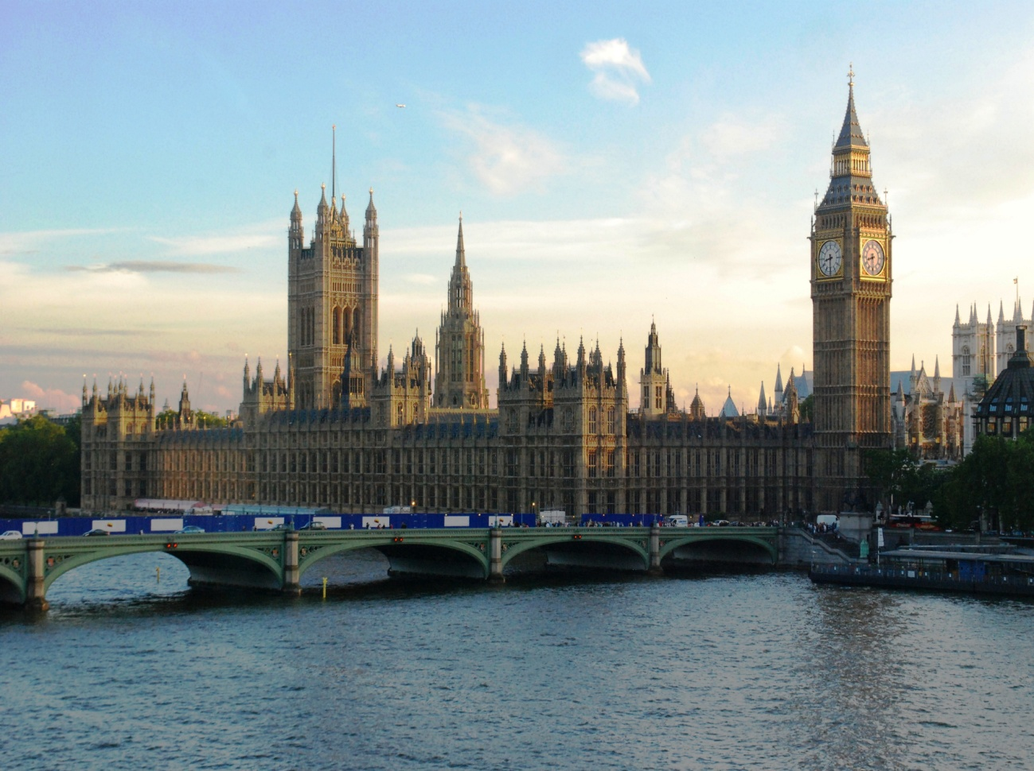
Westminster Palace and Big Ben

